Slide 1
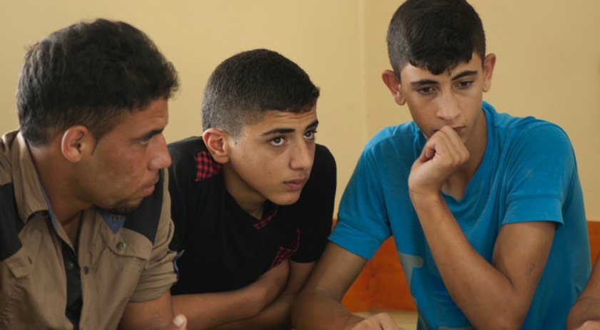
Psychosocial Support for Young Men

Slide 2
Training programme
Day 1: Psychosocial support for young men
Day 2: Planning and implementing psychosocial
activities for young men

Slide 3
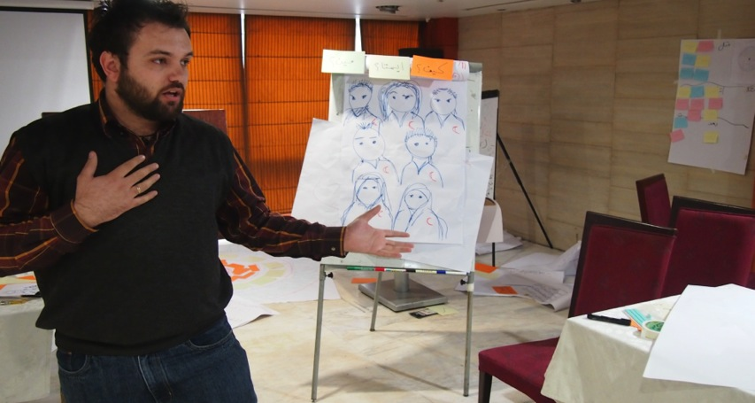
Group Values

Slide 4
What is psychosocial support?
Psycho- logical
Social/ cultural
Feelings
Emotions
Thoughts
Beliefs
Perceptions
Behavior
Traditions
Values
Upbringing
Relationships
Family
Community

Slide 5
Why provide psychosocial support?
To strengthen:
Resilience – the ability to bounce back after something difficult has happened, or to get through difficult experiences in a positive way
Coping mechanisms - the ability to deal with challenges and difficult situations
Restoring social cohesion – networks and structures

Slide 6
Psychosocial activities
Activities can strengthen resilience by enhancing:
Sense of safety
Calm
Belief in ones own or the community’s ability to complete tasks and reach goals
Connectedness
Hope

Slide 7
Group activity
Group 1: Define safety? When do you feel safe?
Group 2: Define calm? When do you feel calm?
Group 3: How do you know when your actions matter?
Group 4: What are the most important social connections in your society?
Group 5: Define hope? When is it important?

Slide 8
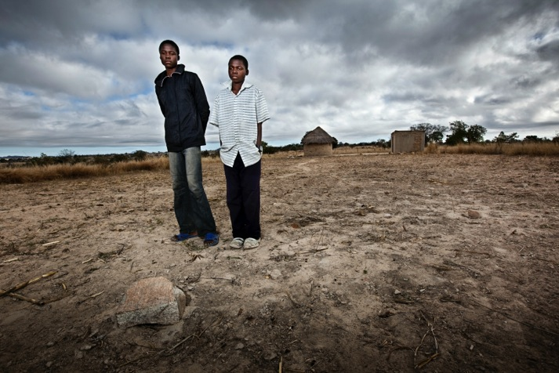
Difficult life circumstances

Slide 9
Characteristics of difficult life circumstances
Have a strong emotional effect on people
Seem impossible to change
Powerful
Usually outside the range of ordinary experience
May overwhelm effective coping skills of an individual or group

Slide 10
Factors influencing life
Protective factors literally ‘protect’ people, reducing the impact of hardship and difficulties
Risk factors literally put people ‘at risk,’ increasing the impact of hardship and difficulties

Slide 11
The psychosocial impact in your community
Discussion in groups:
Which factors increase the level of distress in your community?
Which factors increase the psychosocial wellbeing in your community?

Slide 12
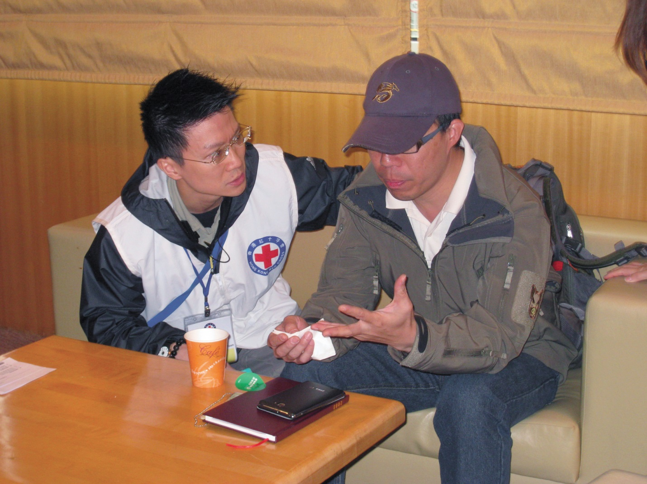
Coping and Assisting

Slide 13
Personal resilience qualities
Ability to make realistic plans and carry them out
Having a positive image of oneself
Feeling self-confident
Having the ability to adapt easily to new situations
Being able to deal with strong emotions
Being able to communicate feelings and thoughts
Believing that change can happen

Slide 14
Ways of coping
Brain storm:
Think of positive ways of coping in your community. What are the outcomes of positive coping?
Think of negative examples of coping. How does negative coping affect the community?

Slide 15
Common signs of stress
Physical signs (stomach ache, tiredness)
Cognitive signs (difficulty in concentrating, losing track of time)
Emotional signs (anxiety, being sad, feeling aggressive, feeling useless)
Behavioural sign (alcohol abuse, withdrawal, aggressiveness)

Slide 16
Normal reactions to abnormal situations
Discussion in groups:
What are the usual signs and reactions of stress?
- Describe at least five types of reactions to stress.

Slide 17
  Key points in assisting young people
Clarify the problem and provide relevant practical information
Support the young people in identifying possible solutions
Deal with the ‘here and now’
Accompany, support and coach, rather than giving direct advice

Slide 18
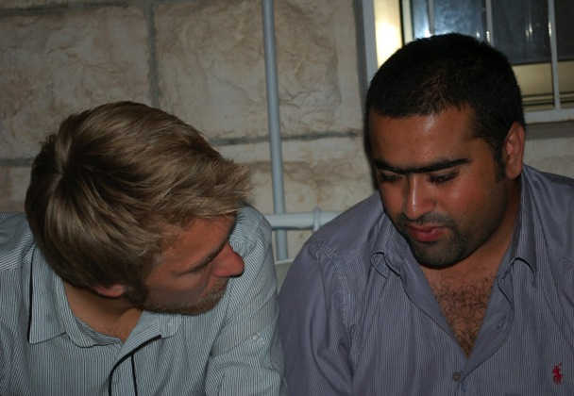
Active listening
Brainstorming:
What is “active listening”?
How do you do it?

Slide 19
Active listening (1)
Maintain eye contact (if appropriate) without gazing
Give room to talk and focus on what is being said
Use clarifying questions and summarizing statements,
Avoid giving opinions or arguing
Avoid being distracted

Slide 20
Active listening (2)
Use body language to convey your attention
Use words like ‘yes’, and ‘hm’, and ‘go on’
Be attentive
Allow time for silence and reflections

Slide 21
Activity: active listening
Pair exercise:
The listener: listens actively by asking clarifying and summarising questions.
The speaker: chooses a personal story from everyday life that is not related to a crisis event

Slide 22
  What is Psychological First Aid?
Psychological First Aid is caring support offered to people who have experienced a very distressing event or situation

Slide 23
  Where is Psychological First Aid provided?
Psychological First Aid can be provided anywhere safe for the first-aider and
the person seeking help.

Slide 24
  When is Psychological First Aid needed?
Immediately for someone in acute distress
When someone continues to experience distress
When someone needs the emotional and practical support

Slide 25
Step-by-step PFA actions
Make contact
Keep safe
Provide quiet and privacy
Practical comfort
Listen
Normalize feelings
Help prioritise needs
Connect with loved ones
Give information

Slide 26
  Peer support
Providing comfort by listening
Helping people to make informed decisions
Everyone has a role and can contribute with different skills or knowledge

Slide 27


  The role of peer supporters
Psych Psychosocial Support for Young Men - MODULE 1
DON’TS
DO’S
Yellow: what can you do as a peer supporter?
Pink: what do you not do as a peer supporter?

Slide 28
Barriers when providing peer support
Own life experiences may influence the support we provide
Be aware not to judge other people based on own biases or beliefs, morals or experiences
Be aware of subconscious, personal issues

Slide 29
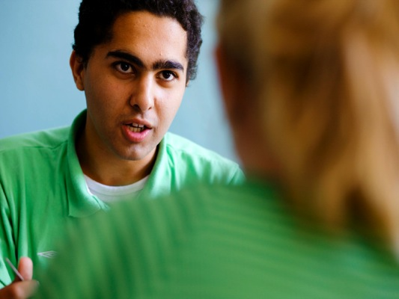
  How do we support others?
Pair exercise:
  Brainstorm about what affects the way we listen?

Slide 30
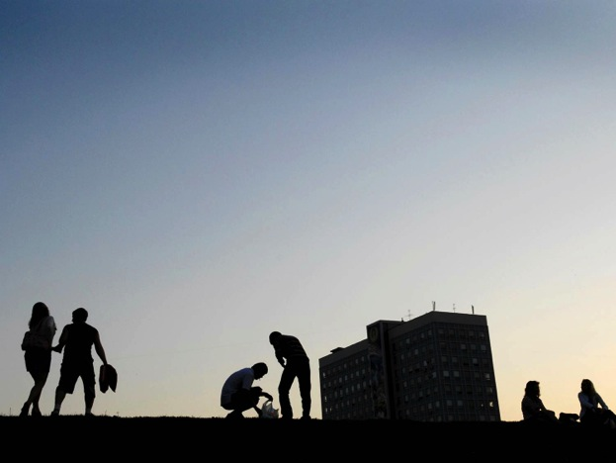
  Wind up the day and check out

