Slide 1
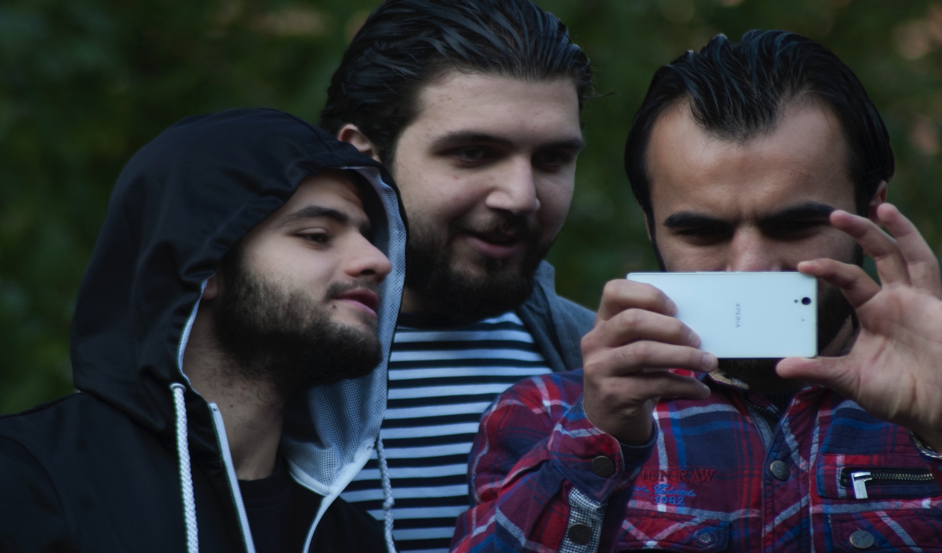
DAY 2 – Psychosocial activities for young men

Slide 2
What is youth?
Discuss in groups:
What characterizes the time or phase in life that is considered as ‘youth?’

Slide 3
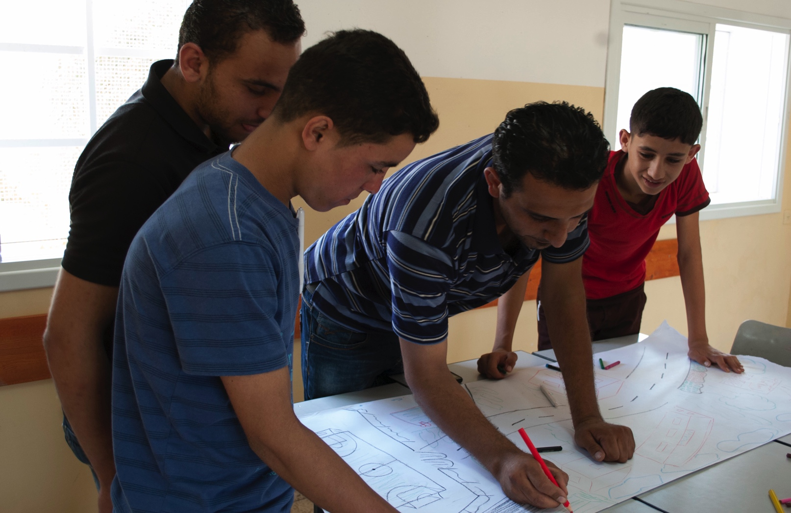
  Young men’s role in the community

Slide 4
  Our community
Group work
Draw a map of your community the way you would like it to look.
What can you do to make this “dream community” come true?
Present your maps in plenary.

Slide 5
  Making change
To make changes we need:
Initiative
Ability to attract and use adult support
Ability to use peer support
Curiosity and intellect
Ability to trust in others
Focus on possibilities and resources
Ability to help others
Belief our actions can make a change

Slide 6
Aims of psychosocial activities for young men
enhancing trust and tolerance
preventing conflicts
be active agents in rebuilding communities
enhancing emotional wellbeing and coping mechanisms
protecting youth and community members from harmful events
Providing a safe place, enabling youth to develop and learn
improving the support mechanisms linking young people and their peers
enhancing social support mechanisms within communities

Slide 7
  Planning psychosocial activities
It is important to consider:
Why are we doing this?
What do we want to change and achieve?
What do we want the young men to learn?

Slide 8
Information about participants
Age
The challenges and needs of the participants
Participants expectation for the planned activity
Motivation for coming to the activity
Special individual needs

Slide 9
    Organising the activities
To consider in advance:
Time frame
Venue
Setup Materials
How will you be introducing yourself?
How will you introduce the purpose of the activity?

Slide 10
Working with youth
Build on their reality and experiences
Set specific goals
Use varied methods
Make relevant and meaningful activities
New skills and knowledge can be put into effect immediately.

Slide 11
  Planning psychosocial activities
Discuss the following in groups of 3 to 4 people:
What is the activity about?
What positive outcomes are you aiming for?
How will the activity enhance psychosocial wellbeing?
Practical arrangements needed for the activity?
Resources needed?
What kind of activities will you do? Explain how you will organize the session.
What kind of reactions should you be prepared for?

Slide 12
    How to deal with emotions
Do not probe participants’ experiences
Demonstrate ways of responding to difficult feelings
Give participant space to react - and listen to what they say
Link up

Slide 13
  Dealing with participants’ responses
Listen sensitively and maintain eye contact
Do not interrupt but watch for signals indicating another participant’s desire to respond
Acknowledge responses with encouragement
Use diplomacy with misunderstandings and/or conflicts

Slide 14
    Supporting participants
Have group values
Encourage participants to voice their views, concerns and different point of views – and respect them
Offer participants reassurance, encouragement and support
Make sure that each member of the group feels valued

Slide 15
  Activity methods
Group work
Theater/Role play
Debates/Discussions
Sport and physical activities
Art

Slide 16
  Activity catalogue - theme boxes
Art-based
Physical/sport
Life-skills
Plus examples of safe spaces

Slide 17
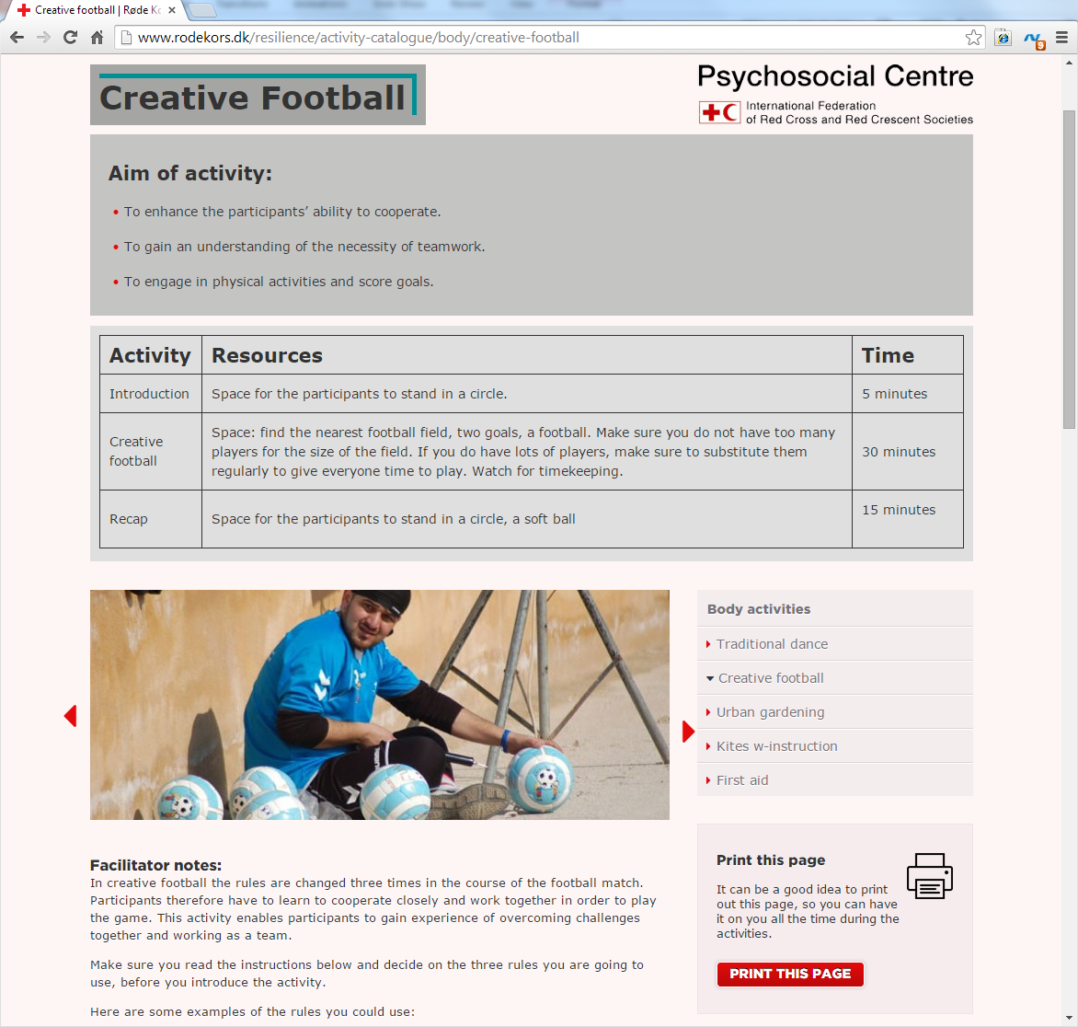
Example of Activity

Slide 18
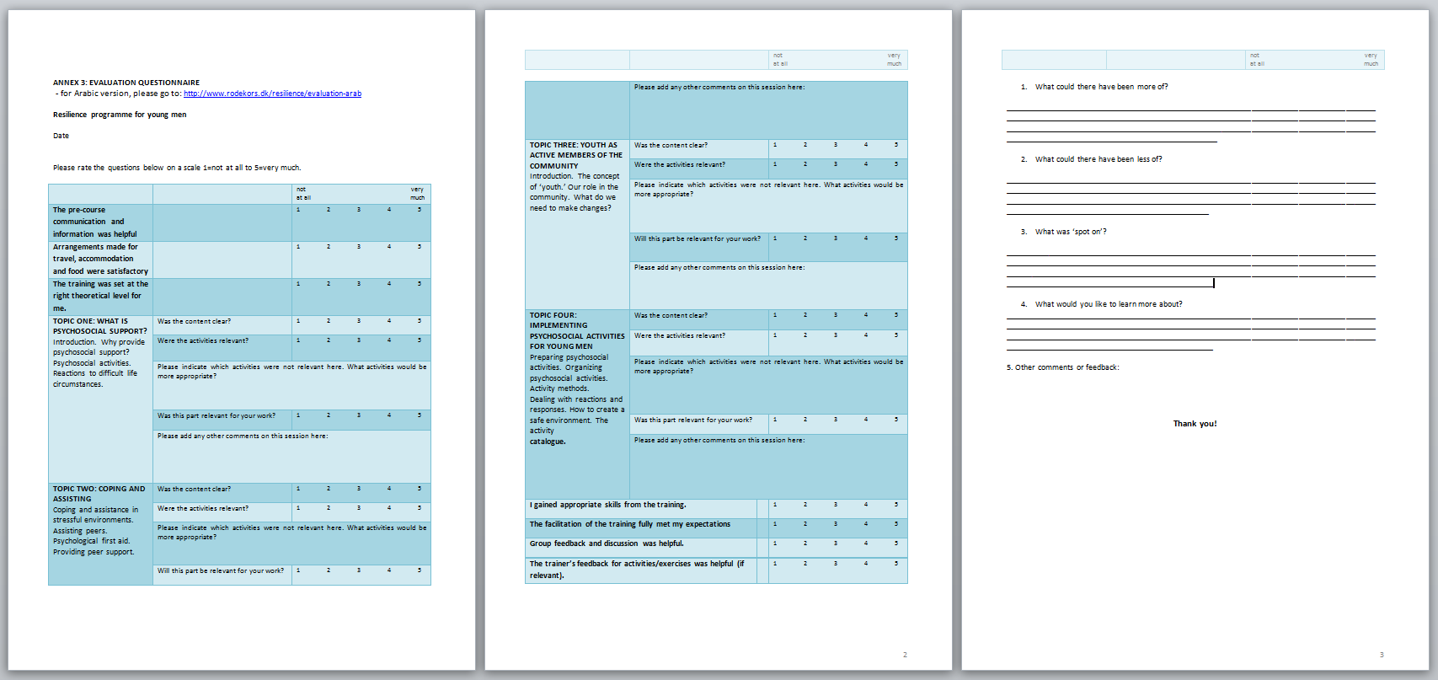
  Evaluation and saying goodbye

